Slide 1
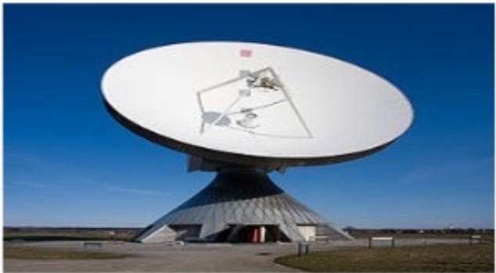
Parabolic Reflector/Dish Antenna

Slide 2
Parabolic Reflector/Dish Antenna
A parabolic antenna is a high-gain reflector antenna used for radio, television and data communications, and also for radio location (radar) on the UHF and SHF parts of the electromagnetic spectrum •
Why is it used?
At higher microwave frequencies the physical size of the antenna becomes much smaller which in turn reduces the gain and directivity of the antenna •
The desired directivity can be achieved using suitably shaped parabolic reflector behind the main antenna which is known as primary antenna or feed .

Slide 3
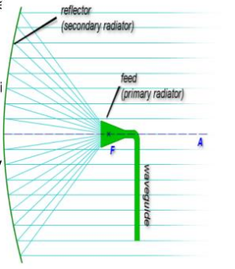
Basic Working Rules
A parabolic reflector follows the principle of geometrical optics. When parallel rays of light incident on the reflector they will converge at focus or when a point source of light is kept at focus after reflection by the reflector they form a parallel beam of rays.
1
2

Slide 4
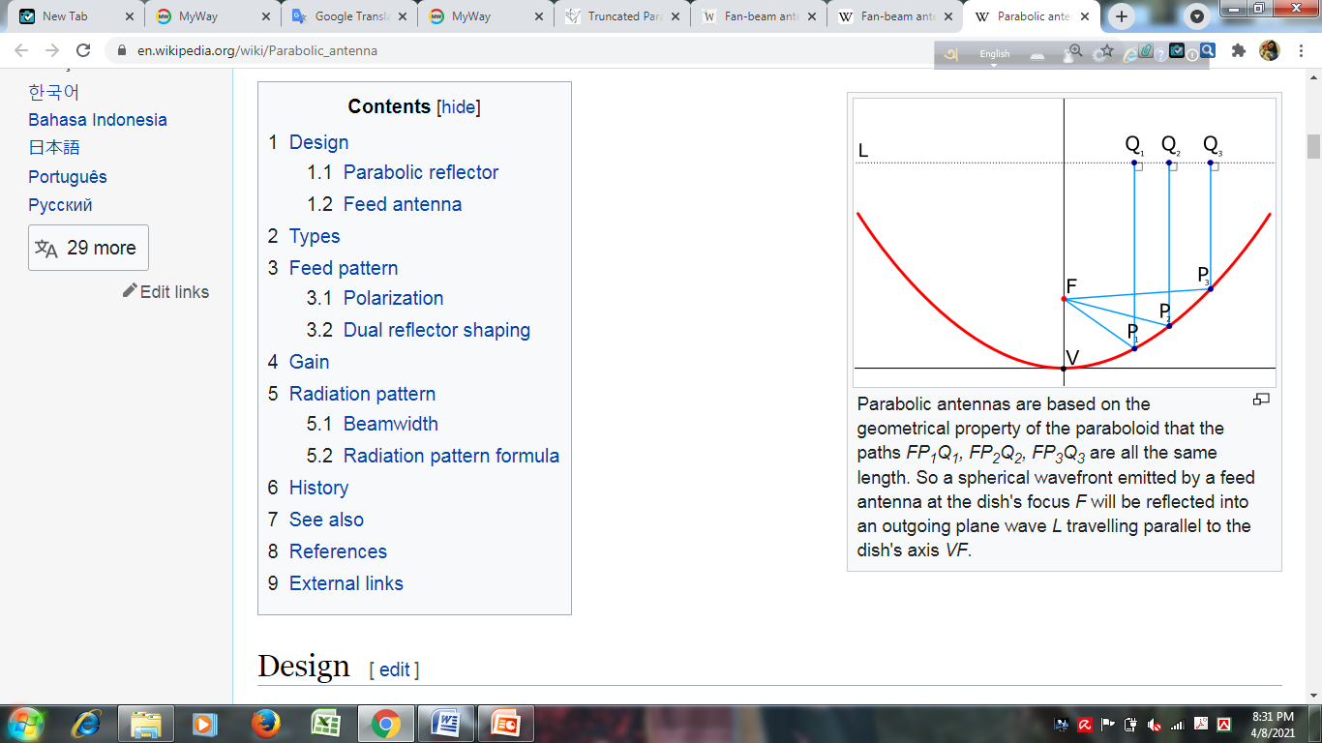

Slide 5
Types of Common Paraboloids

Slide 6
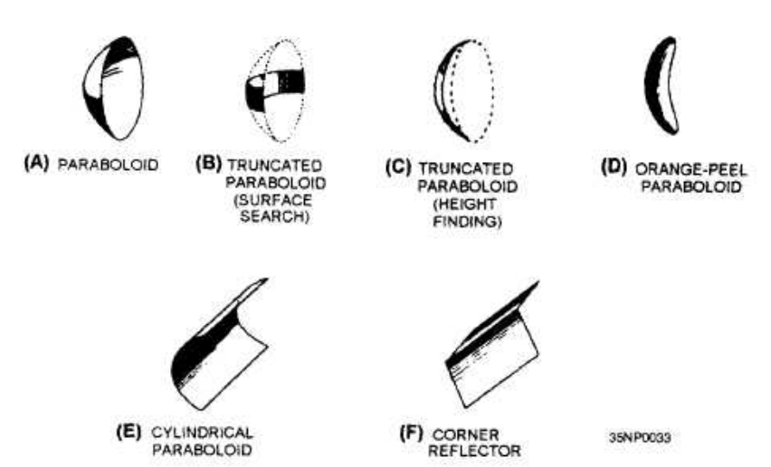

Slide 7
Truncated Paraboloid
When the reflector is parabolic in the horizontal plane, the energy is focused horizontally into a narrow beam. With the reflector is truncated (cut) so that it is shortened vertically, the beam spreads out vertically instead of being focused. It will detect aircraft at different altitudes without changing the tilt of the antenna, also works well for surface search radar applications.
When the reflector is parabolic in the vertical plane, the energy is focused vertically into a narrow beam. With the reflector is truncated, or cut, so that it is shortened horizontally, the beam will spread out horizontally instead of being focused. Such a fan-shaped beam is used to accurately determine elevation and target height-finding systems.

Slide 8
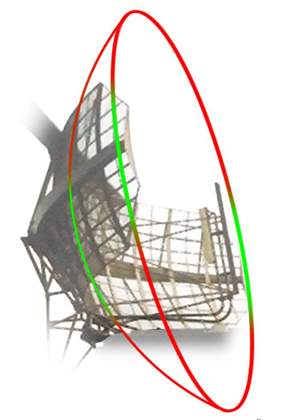

Slide 9
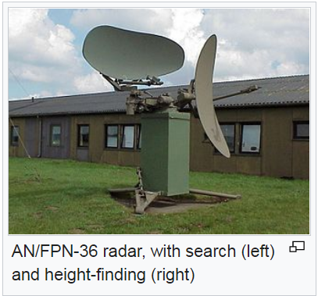

Slide 10
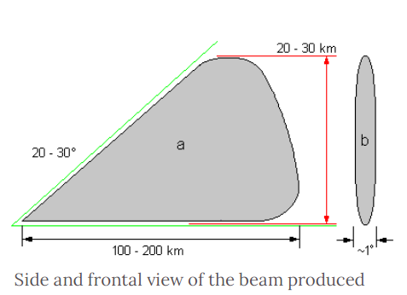

Slide 11
Orange-Peel Paraboloid
A section of a complete circular paraboloid, often called an orange-peel reflector because of its orange-peel shape. Since the reflector is narrow in the horizontal plane and wide in the vertical plane, it produces a beam that is wide in the horizontal plane and narrow in the vertical plane. Orange-peel paraboloids are often used in height-finding equipment.

Slide 12
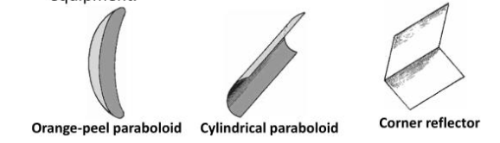
Cylindrical Paraboloid
The reflector is curved in only one direction and flat in the other. The radio waves come to a focus not at a point but along a line. That is the reflector surface is fed by a line source which is placed at the focal line of the reflector. The feed is sometimes a dipole antenna located along the focal line. Cylindrical parabolic antennas radiate a fan-shaped beam, narrow in the curved dimension, and wide in the other dimension.

Slide 13
Corner Reflector
The corner reflector consists of two flat conducting sheets that meet at an angle to form a corner. The corner reflector is normally driven by a half wave radiator located on a line which bisects the angle formed by the sheet reflectors.

Slide 14
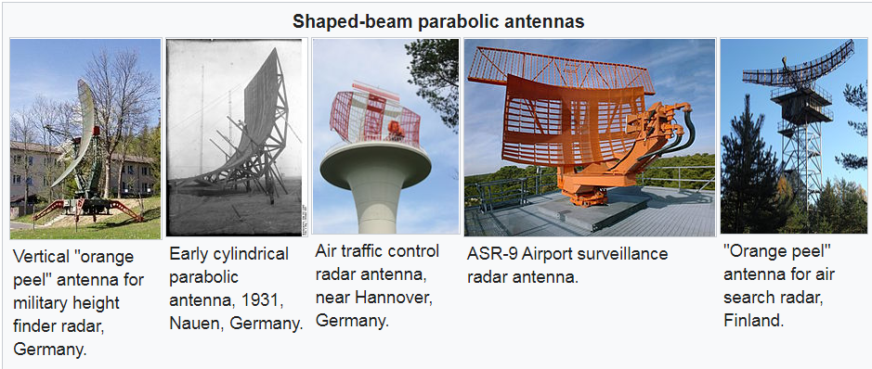

Slide 15
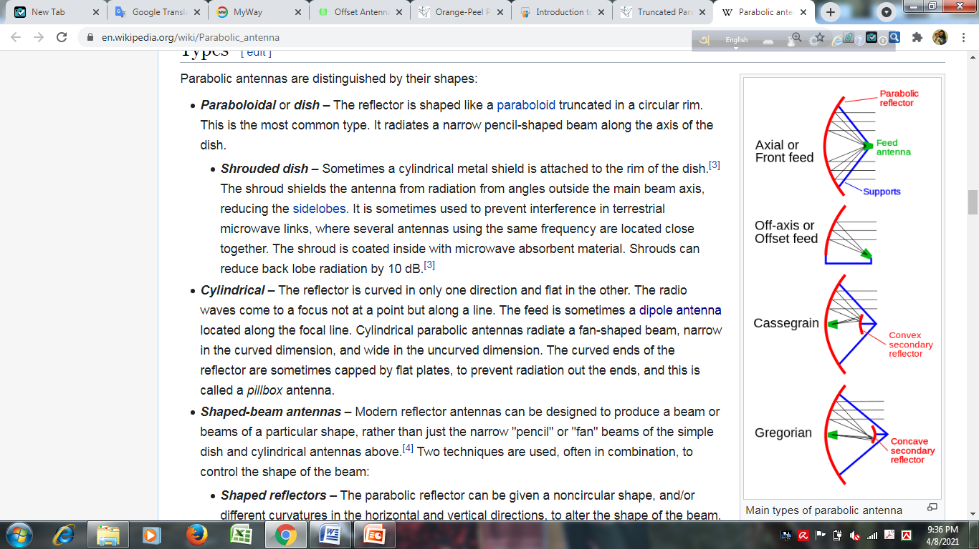
Types of Microwave feeder/
Driven Element
Axial
Off-axis
Cassegrain
Gregorian

Slide 16
Axial Feed
This is the most common type of feed, with the feed antenna located in front of the dish at the focus, on the beam axis, pointed back toward the dish.
A disadvantage of this type is that the feed and its supports block some of the beam, which limits the aperture efficiency to only 55–60%.

Slide 17
Off-Axis/ Offset Feed
The reflector is an asymmetrical segment of a paraboloid, so the focus, and the feed antenna, are located to one side of the dish. The purpose of this design is to move the feed structure out of the beam path, so it does not block the beam. It is widely used in home satellite television dishes, which are small enough that the feed structure would otherwise block a significant percentage of the signal. Offset feed can also be used in multiple reflector designs such as the Cassegrain and Gregorian
feed.

Slide 18
Cassegrain
In a Cassegrain antenna, the feed is located on or behind the dish, and radiates forward, illuminating a convex hyperboloidal secondary reflector at the focus of the dish. The radio waves from the feed reflect back off the secondary reflector to the dish, which reflects them forward again, forming the outgoing beam.
it is used for antennas with complicated or bulky feeds, such as large satellite communication antennas and radio telescopes. Aperture efficiency is on the order of 65–70%.

Slide 19
Gregorian
Similar to the Cassegrain design except that the secondary reflector is concave, (ellipsoidal) in shape. Aperture efficiency over 70% can be achieved.

Slide 20
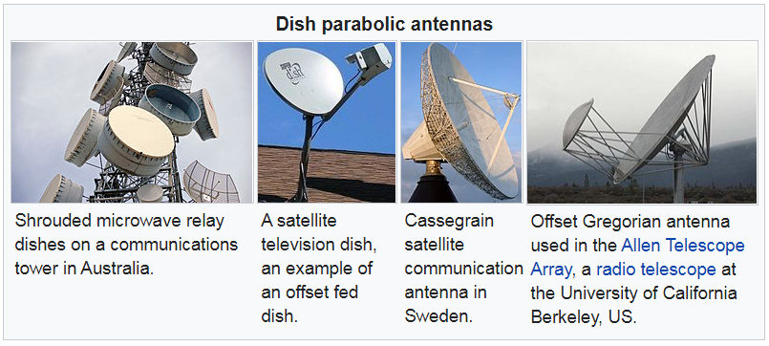

Slide 21
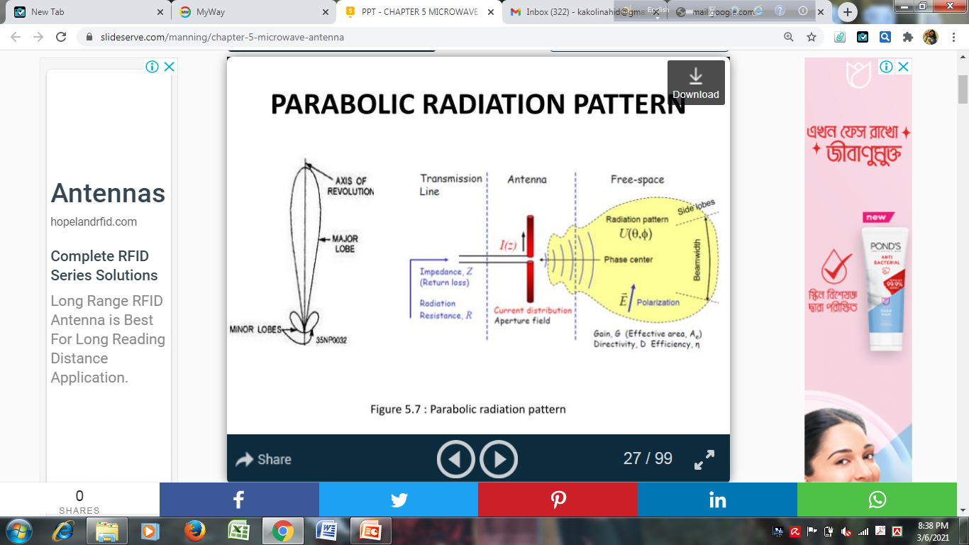
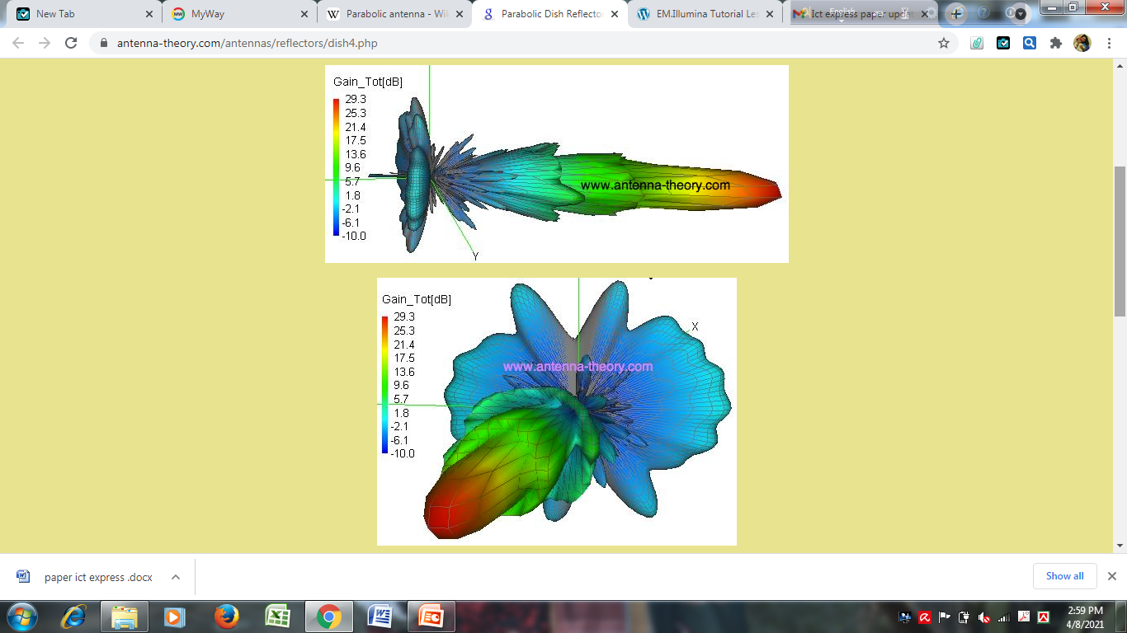
Radiation Pattern
The pattern is highly directional. The HPBW is approximately 5 degree

Slide 22
Gain-Beamwidth
Gain: G = 4 π A/ λ²
Where; G = gain; A = area of parabolic dish (m²); λ = wavelength of operational frequency (m).
Area of the dish: A = π d²/4
Where; A = area of parabolic dish (m²); d = diameter of dish opening (m).
Beamwidth α = 115 λ /d °
α = antenna beamwidth or angle between half power points ( °)
λ = wavelength (m)
d= diameter of dish opening (m)

